Slide 1
Diabetes Demographics
in Colorado
By: Liz Eli, Jay Spears, Ryan Eberle, Mary Casey
Notes:
* Title Slide
* Include the name of the Project and Group Members

Slide 2
Motivation / Summary
Visualization project of diabetes rates along Age, Income, Food Security, and Urban/Rural settings in the state of Colorado.
Effectiveness in health awareness programs and education come from a greater understanding of the demographics involved. By identifying these areas within the population, resources can be aimed with greater precision. The growing field of population health is aimed at providing better outcomes at lower costs, by improving the delivery of health services. This approach aims at raising the overall health of a given population, ultimately leading to cost efficiency and more standardized services.
By visualizing the demographics of Colorado along age, income, food security, and urban/rural settings as they pertain to diabetes rates, the aim is to identify areas within the state's population that would benefit from allocation of resources and education.
Notes:
* Motivation & Summary Slide
* Define the core message or hypothesis of your project.==
* Describe the questions you asked, and _why_ you asked them==
* Describe whether you were able to answer these questions to your satisfaction, and briefly summarize your findings==

Slide 3
Questions and Data
Does age factor with diabetes rates among the population of Colorado?
Are there diabetic rate differences among the residents of Colorado that reside in either Urban or Rural settings?
Does income and the rates of poverty have an impact on the rates of diabetes per County in the state of Colorado?
Do LILA tract designations have an effect on the rates of diabetes in Colorado?
Data Sources:
USDA Food Environment Atlas Data for Colorado Census Tracts (2017)/ Diabetes in Adults - CDPHE Community Level Estimates (Census Tracts) (2014-2017)/ Diabetes Hospitalization Rate (Census Tracts) (2013-2017)/ Income/Poverty (Census Tracts) (2014-2017)/ Current Prevalence of Diabetes - Center for Disease Control(2011-2020)/ Educational Attainment (Census Tracts) (2013-2017)/ All resources were accessed from CDPHE Open Data: https//data-cdphe.opendata.arcgis.com/
Using the above sources, the data will be visualized across multiple charting methods.
Notes:
Questions & Data
* Elaborate on the questions you asked, describing what kinds of data you needed to answer them, and where you found it

Slide 4
Data Cleanup and Exploration
All datasets from Colorado Department of Public Health & Environment
Downloaded datasets as .csv’s
Put them into dataframes
Renamed columns so that all datasets could be merged on the key “FIPS” (Federal Information Processing Standards) by which Census Tracts are identified
Did repeated dataframe merges until all datasets were in one dataframe
Narrowed to only needed columns and renamed columns
Formatted columns for prettier display
Notes:
*
Data Cleanup & Exploration
* Describe the exploration and cleanup process
* Discuss insights you had while exploring the data that you didn't anticipate
* Discuss any problems that arose after exploring the data, and how you resolved them
* Present and discuss interesting figures developed during exploration, ideally with the help of Jupyter Notebook

Slide 5
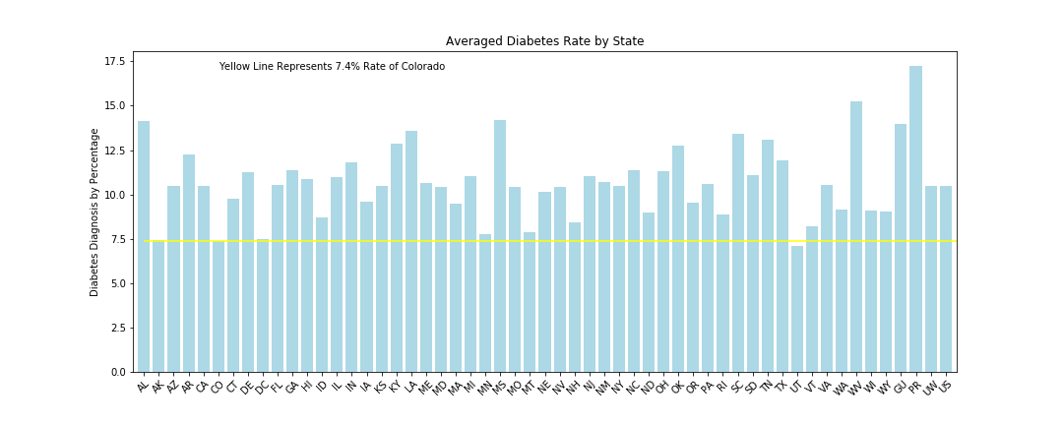
The National Picture

Slide 6
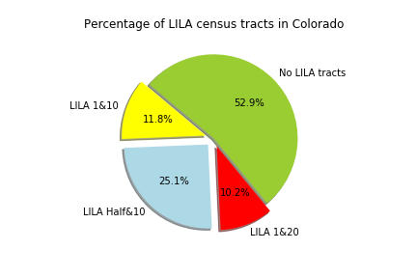
LILA Tracts of Colorado
There are 5,395,805 citizens within the state of Colorado.
There are 1228 census tracts in the state of Colorado.
~~~~~~~~~~~~~~~~~~~~~~~~~~~~~~~~~~~~~~~~~~~~~~~~~~~~~~~~~~~~
Of those 1228 census tracts, 185 are designated LILA 1 and 10.
There are 795,560 people living in LILA 1 and 10 tracts in Colorado.
LILA 1 & 10 census tracts have a 8.54% average diabetes diagnosis percentage.
~~~~~~~~~~~~~~~~~~~~~~~~~~~~~~~~~~~~~~~~~~~~~~~~~~~~~~~~~~~~
Of those 1228 census tracts, 395 are designated LILA Half and 10.
There are 1,694,377 people living in LILA half and 10 tracts in Colorado.
LILA Half & 10 census tracts have a 7.84% average diabetes diagnosis percentage.
~~~~~~~~~~~~~~~~~~~~~~~~~~~~~~~~~~~~~~~~~~~~~~~~~~~~~~~~~~~~
Of those 1228 census tracts, 161 are designated LILA 1 and 20.
There are 725,779 people living in LILA 1 and 20 tracts in Colorado.
LILA 1 & 20 census tracts have a 8.24% average diabetes diagnosis percentage.
~~~~~~~~~~~~~~~~~~~~~~~~~~~~~~~~~~~~~~~~~~~~~~~~~~~~~~~~~~~~
Of those 1228 census tracts, 833 do not contain a LILA designation.
There are 3,701,428 people living in non-LILA designated tracts in Colorado.
Census Tracts without LILA designation have a 6.63% average diabetes diagnosis percentage.
~~~~~~~~~~~~~~~~~~~~~~~~~~~~~~~~~~~~~~~~~~~~~~~~~~~~~~~~~~~~

Slide 7
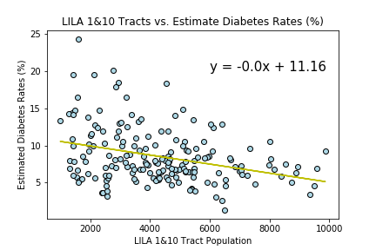
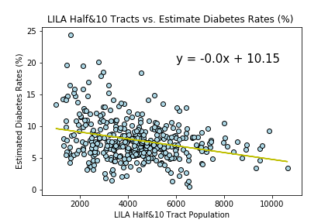
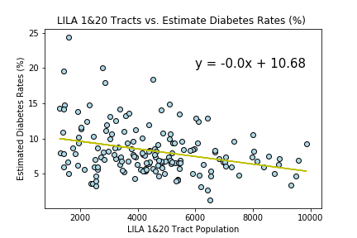
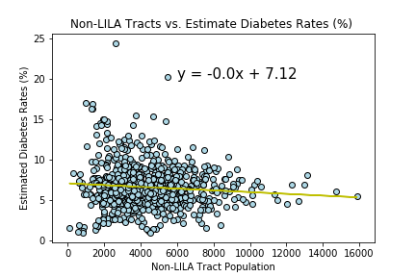
Scatter Plot Census Tract Populations on Diabetes Rates, on a tracts LILA ranking.
Above correlation is -0.33
Below correlation is -0.30
Above correlation is -0.28
Below correlation is -0.09

Slide 8
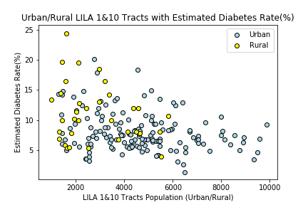
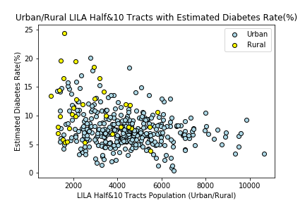
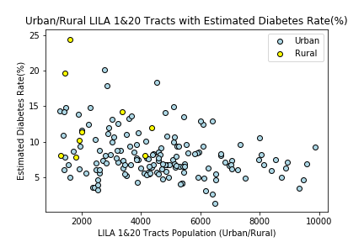
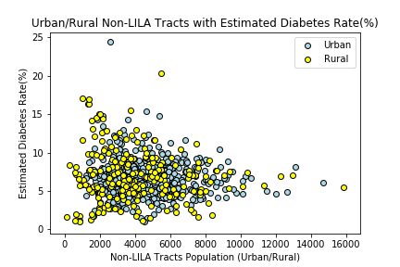
Scatter Plot of LILA Tracts (Urban/Rural) Population & Diabetes Rates

Slide 9
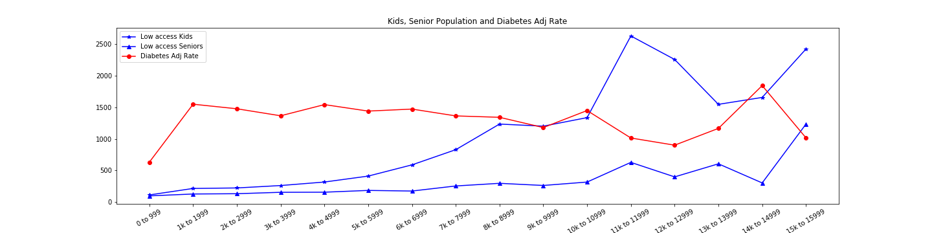
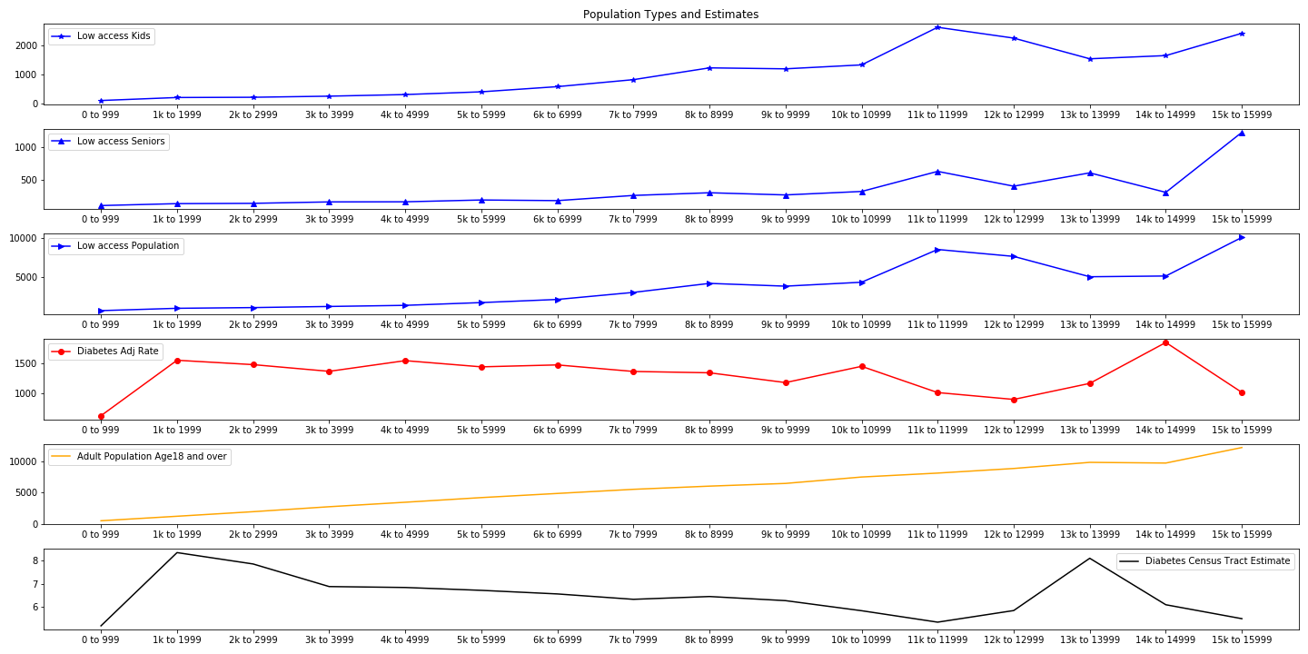
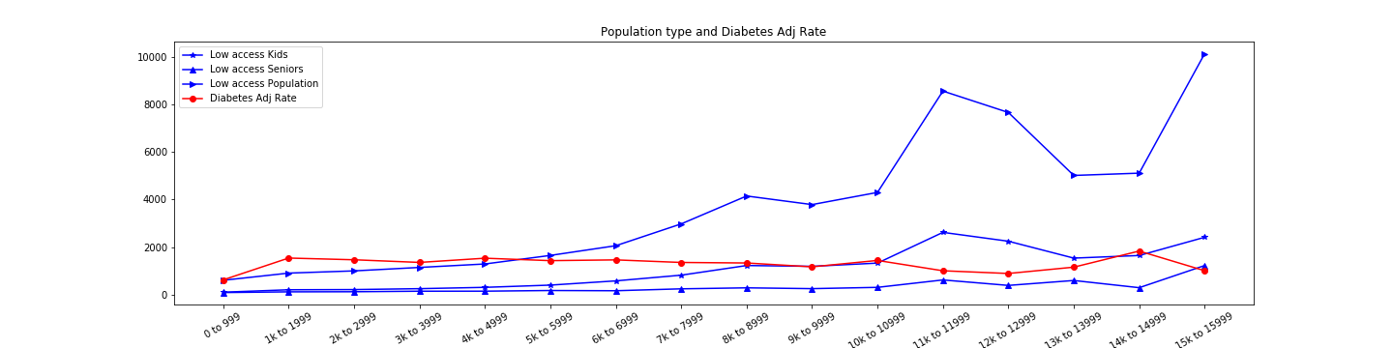
Does age factor with diabetes rates among the population of Colorado?
Bins from populations totals
Searching for correlation in similar sized counties in Colorado
Does the diabetes rate have any relation with low access kids, seniors, or the general low access population.
Notes:
* Data Analysis
* Discuss the steps you took to analyze the data and answer each question you asked in your proposal
* Present and discuss interesting figures developed during analysis, ideally with the help of Jupyter Notebook

Slide 10
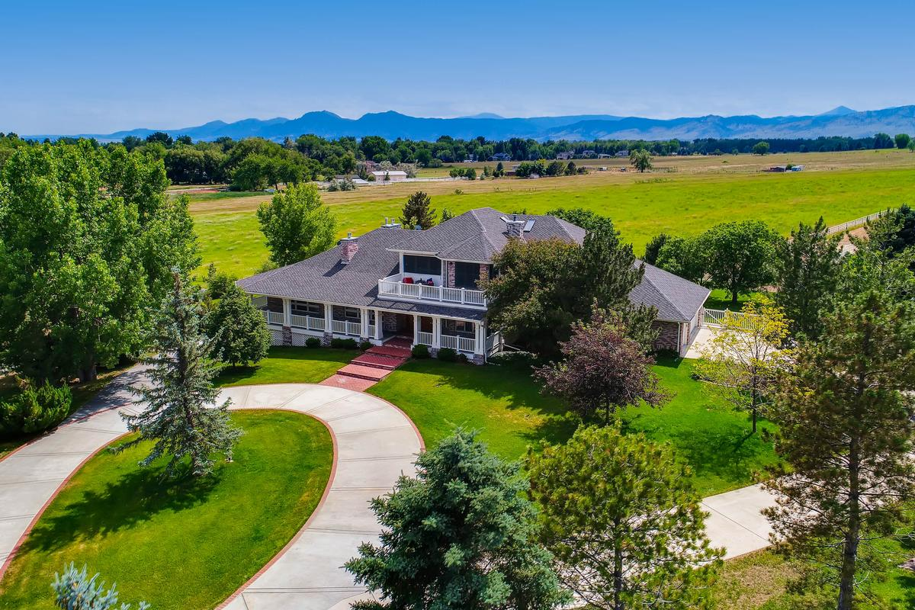
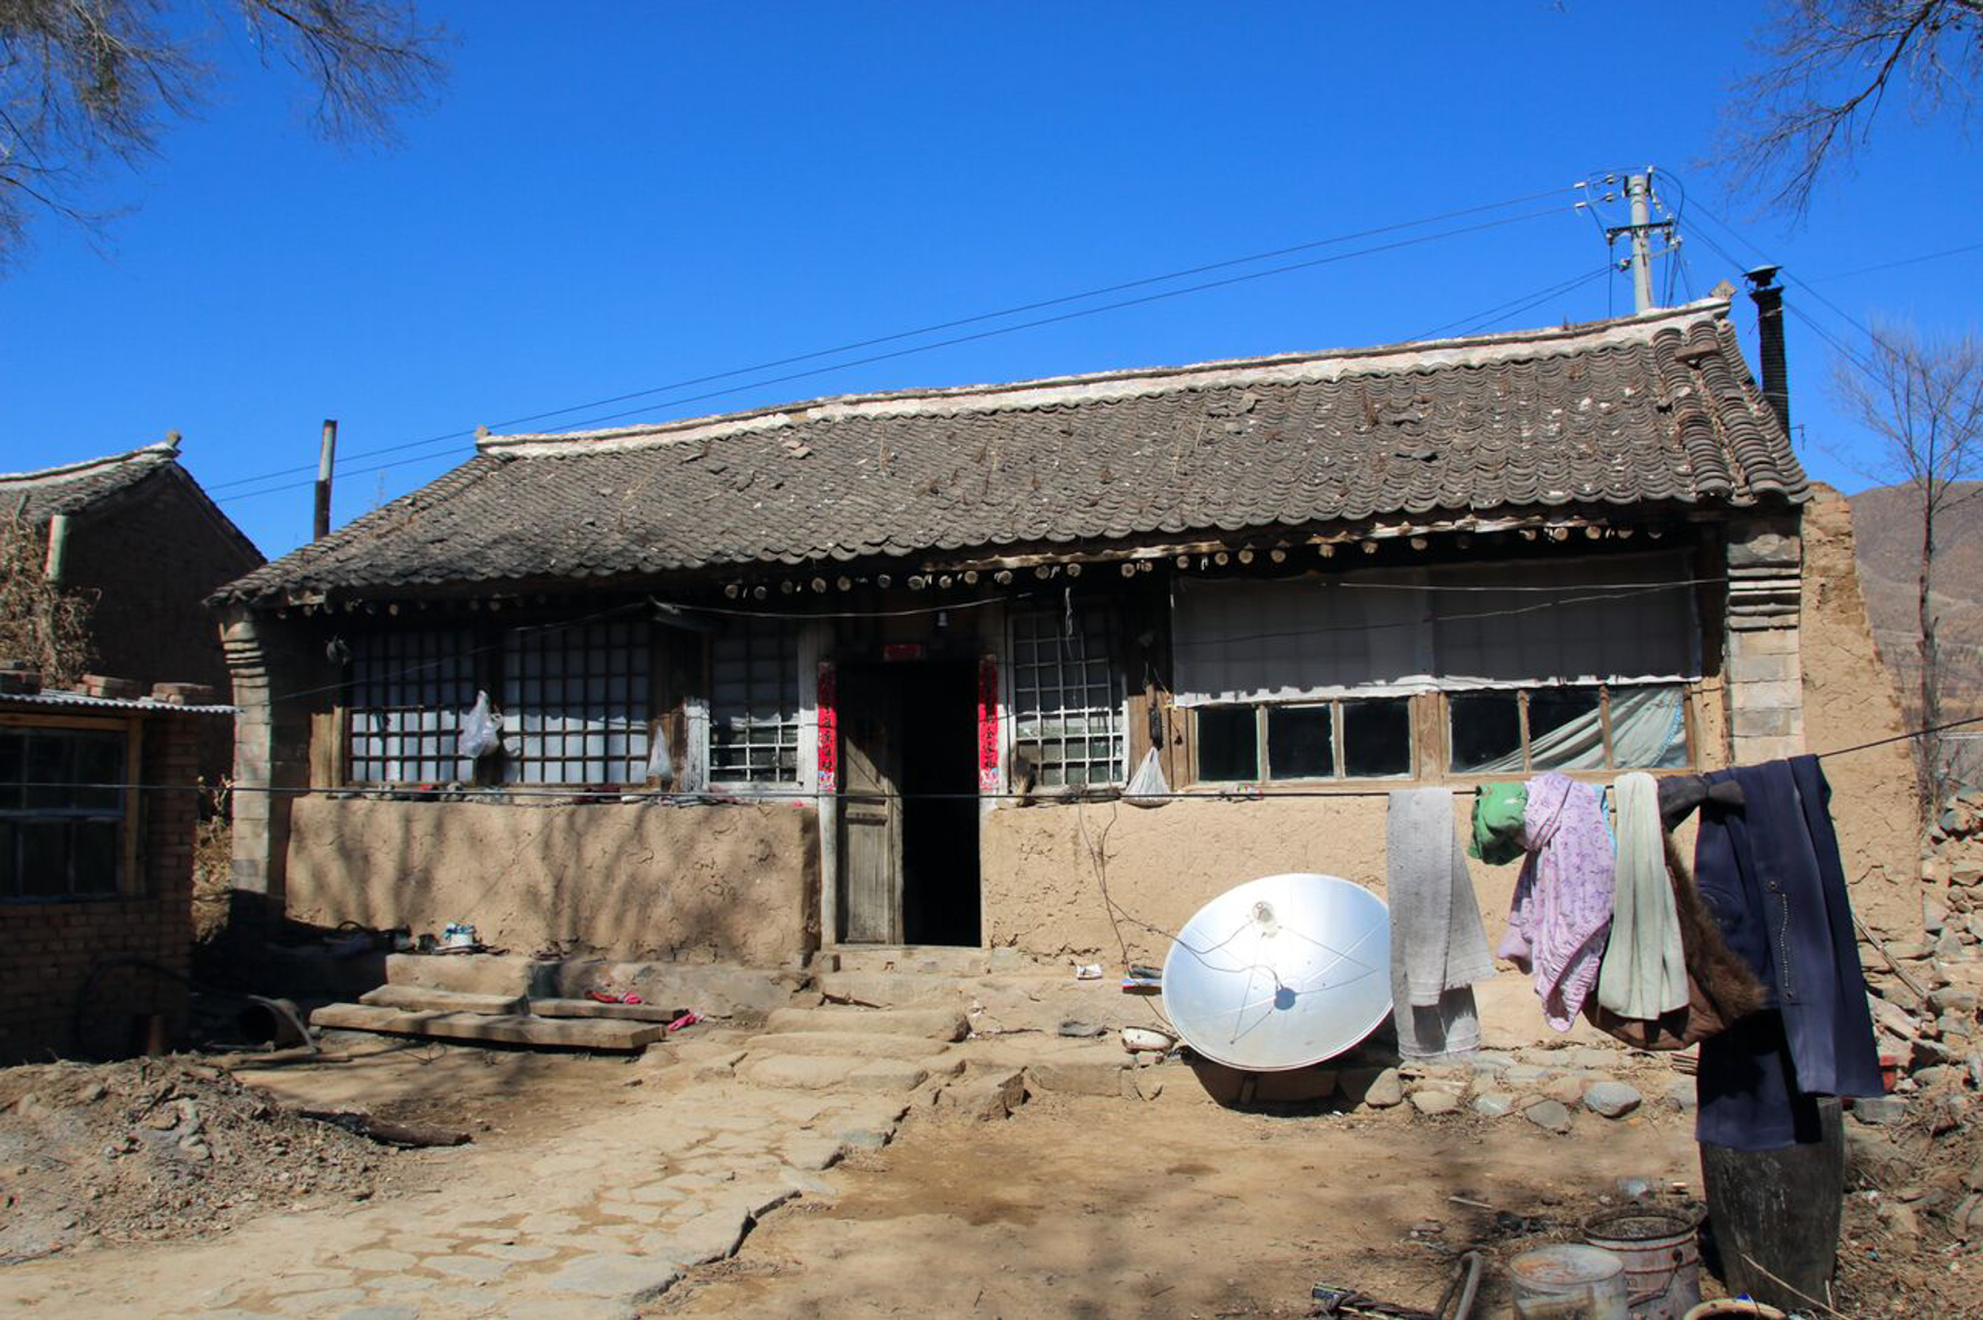
Does income and the rates of poverty have an impact on the rates of diabetes per County in the state of Colorado?
Approach:
Group by county
Create summary dataframes for
Mean Household Income
Diabetes Percent Diagnosis
Percent Poverty
Scatterplots
Mean Household Income vs Diabetes Percent Diagnosis
Percent Poverty vs Diabetes Percent Diagnosis
Notes:
* Data Analysis
* Discuss the steps you took to analyze the data and answer each question you asked in your proposal
Steps I took - how to make data digestible
Came to conclusion that best method would be to categorize or group by county
Combined all census tracts per county to create one mean/median for income, percent pov, and diabetes diagnosis percentages
Used those summary stats to create scatter plots
* Present and discuss interesting figures developed during analysis, ideally with the help of Jupyter Notebook

Slide 11
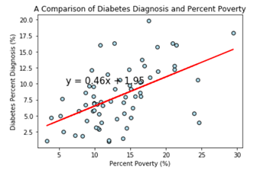
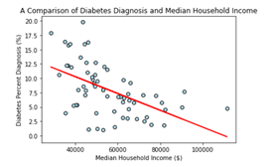
Scatter Plots and Discussion
The correlation between both factors is 0.53
The correlation between both factors is -0.54
Notes:
The first scatterplot shows the relationship between percent poverty and diabetes diagnosis percentages by county
There is a positive correlation between the two - as percent poverty increases, the percent diabetes diagnosis value increases as well
The second scatterplot shows the relationship between median household income and percent diabetes diagnosis. The two are inversely related as would be expected. As income increases, percent diagnosis decreases. It can be speculated that this can be due to several factors, but access to healthy, more expensive food is the first thing that comes to mind with this particular variable
There is an argument that can be made in regards to using median versus mean in regards to household income. Due to the outliers and the potential for said outliers to scew the mean in a way that would make the analysis potentially deceptive, I went with the median. I did end up doing the mean as well and the the trend as well as the correlation coefficient were very similar.
Based on the findings of the analysis done, it would appear that income does have an impact on diabetes diagnosis in the state Colorado. I would have liked to have broken the data down into income brackets of high low and medium categories and done a risk analysis on each income bracket created- but lacked the time to do so.

Slide 12
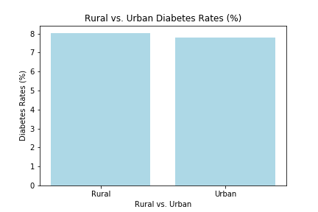
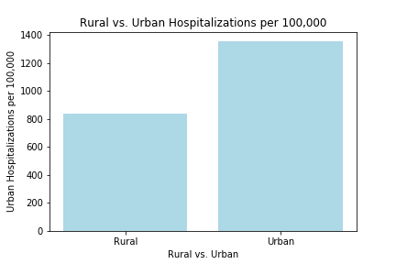
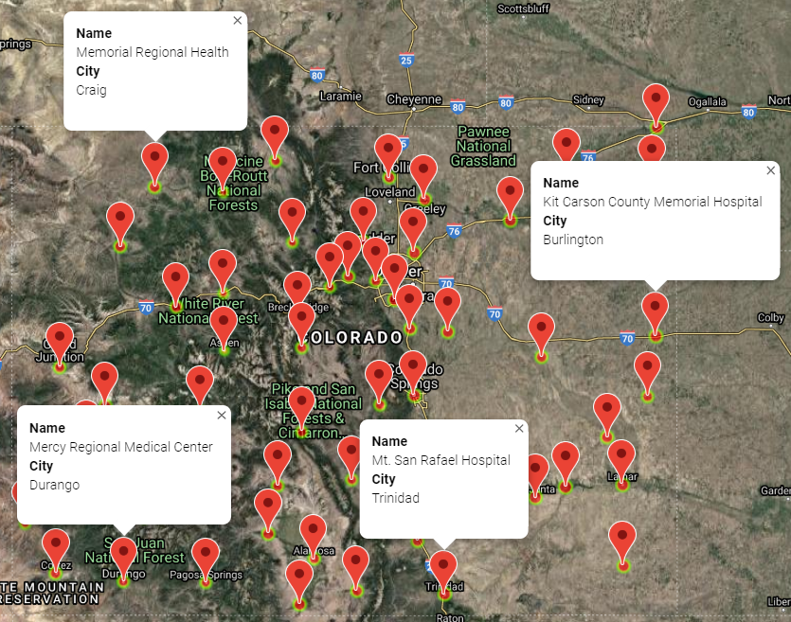
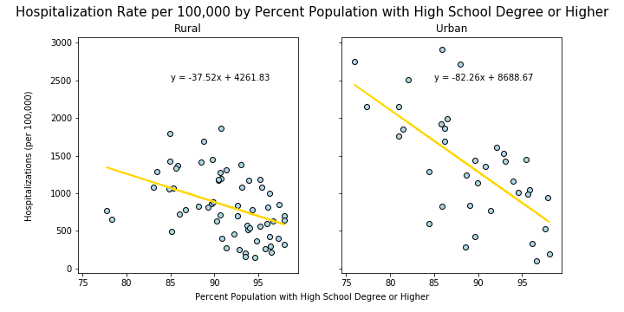
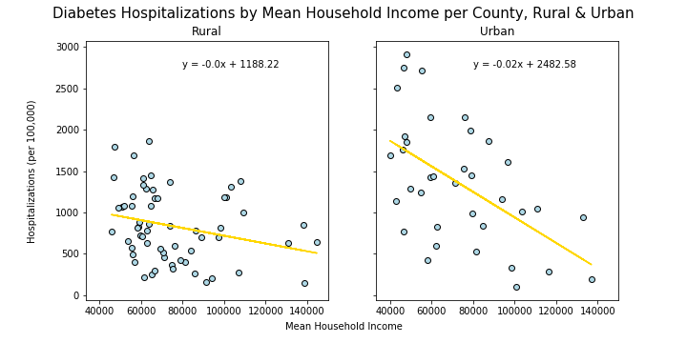
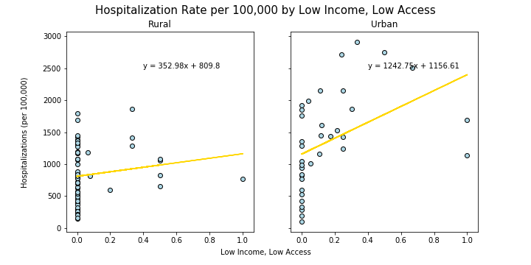
Diabetes Hospitalization Rates, Rural vs. Urban
Notes:
* Data Analysis
* Discuss the steps you took to analyze the data and answer each question you asked in your proposal
Steps I took - how to make data digestible
Came to conclusion that best method would be to categorize or group by county
Combined all census tracts per county to create one mean/median for income, percent pov, and diabetes diagnosis percentages
Used those summary stats to create scatter plots
* Present and discuss interesting figures developed during analysis, ideally with the help of Jupyter Notebook

Slide 13
Discussion & Conclusion
Future analysis opportunities:
- Diabetes rates among families, and income levels
- Mapping LILA tracts against grocers for better understanding of food security
- Diabetes rates over a longer time frame for identifying trend
- Insured rates amongst the diabetic demographic
Issues during analysis:
-Data Format errors
Questions?
Notes:
* Post Mortem
* Discuss any difficulties that arose, and how you dealt with them
* Discuss any additional questions that came up, but which you didn't have time to answer: What would you research next, if you had two more weeks?
* Questions
* Open-floor Q&A with the audience

